Slide 1
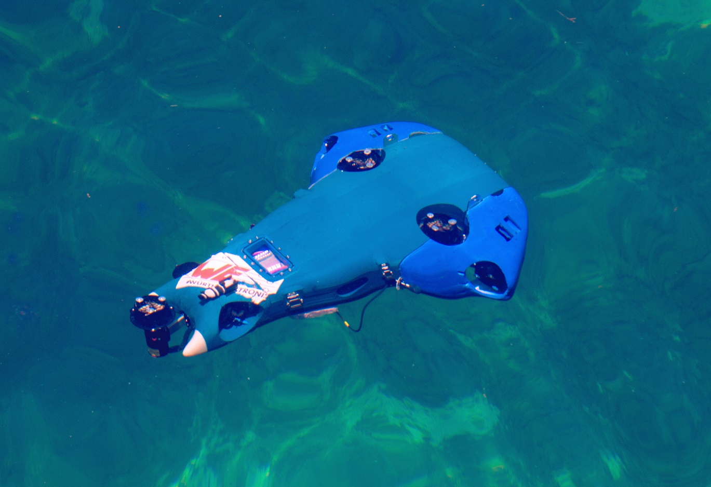
Naiad Mälardalen University, Sweden
Notes:
Hello, my name is Weronica …
We’re from Mälardalen University in Västerås, Sweden and we’re here to present our robot Naiad. The name Naiad comes from a greek mythology fresh water nymph that protect different bodies of water.

Slide 2
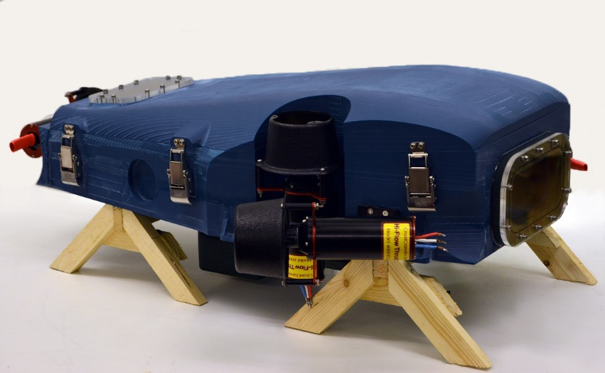
Main hull
Notes:
The main hull was milled out of polyurethane and it is the only compartment of Naiad that needs to be water tight. Water proof down to 150 meters.

Slide 3
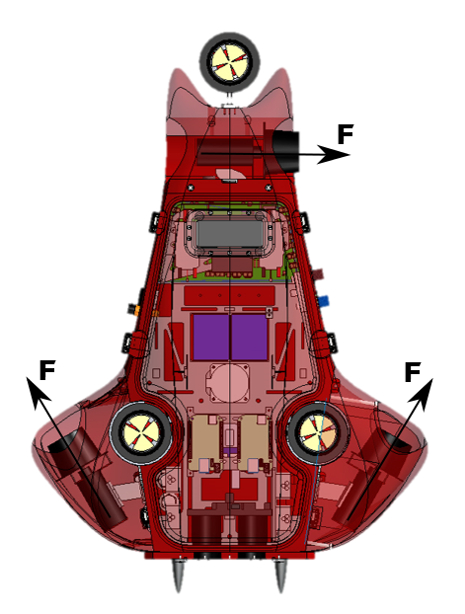
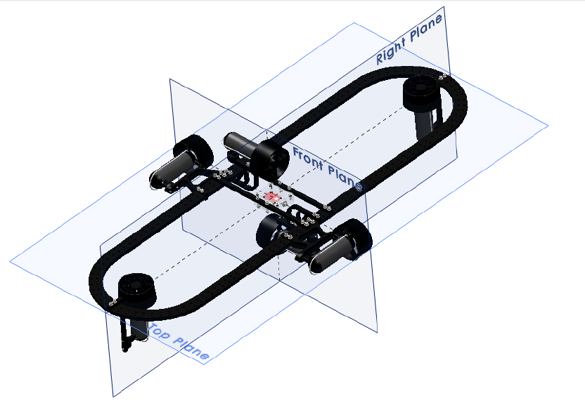
Thruster configuration
Configuration on Naiad
Configuration Vasa
Notes:
Thruster configuration – with the main hull, came the thruster configuration. Compared to Vasa’s thruster configuration this makes Naiad
More stable in plane since it eliminates turbulent water flows around the body of Naiad. It also makes it easier to pitch and roll and very effective in yaw

Slide 4
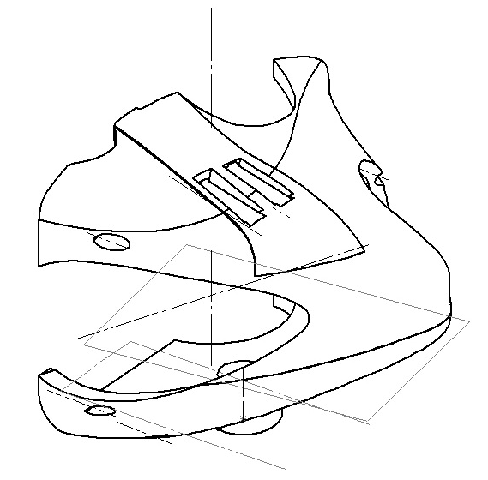
Wings
Design Feature
Helps with hydrodynamics
3D printed
LEDs
Hydrophones
Notes:
The wings of the robot are mainly a feature to help with hydrodynamics. The wings are 3D-printed and have room for LEDs which will make it possible to determine status of the robot whilst it is in the water. The wings also hold two of the three hydrophones.

Slide 5
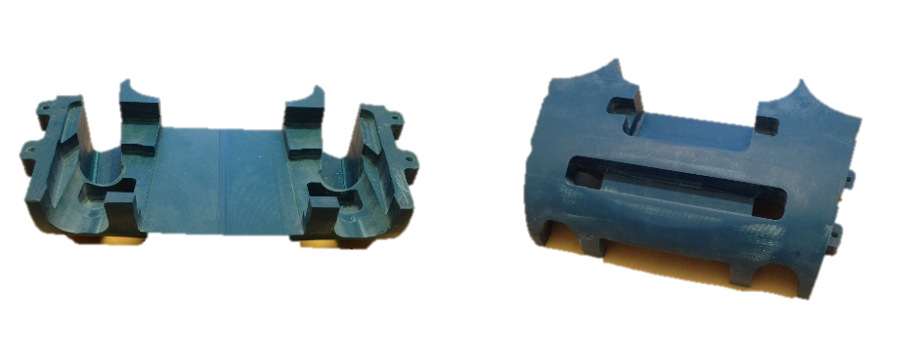
Front tool plate
Headlights
Sonar
Torpedoes
Notes:
The front of the tool plate should hold headlights, an active sonar and the torpedoes. At the moment we have a weight box in the front stabilizing the robot.

Slide 6
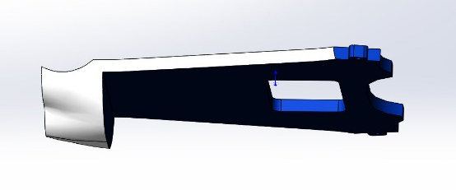
Toolplate
Pneumatics
Sensors
Markers
Gripper

Slide 7
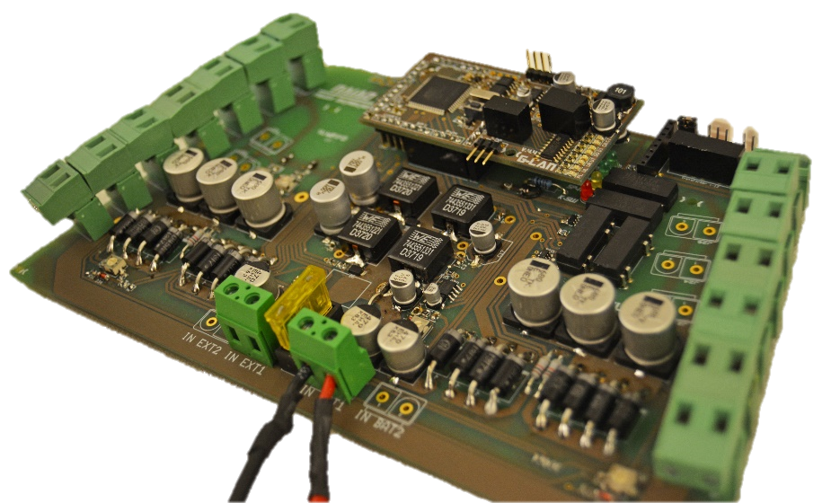
Power Supply Unit
Custom made
Controls power to thrusters and all electronics
100 % hardware kill-switch
Notes:
The Power Supply Unit was
Working and it was Custom made, both its shape (to fit inside the hull) and application. Apart from the desired voltage levels there is a hardware kill switch, which means that an operator in the water can physically break the power to the motors if anything is to happen.

Slide 8
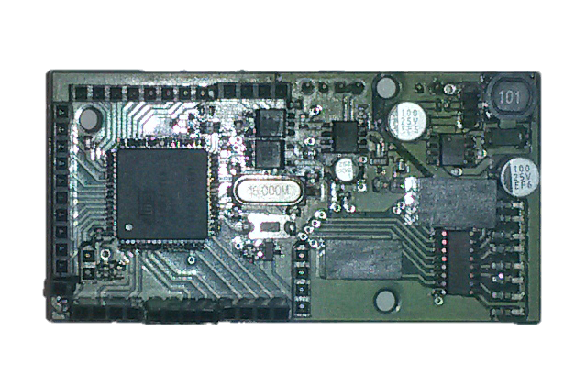
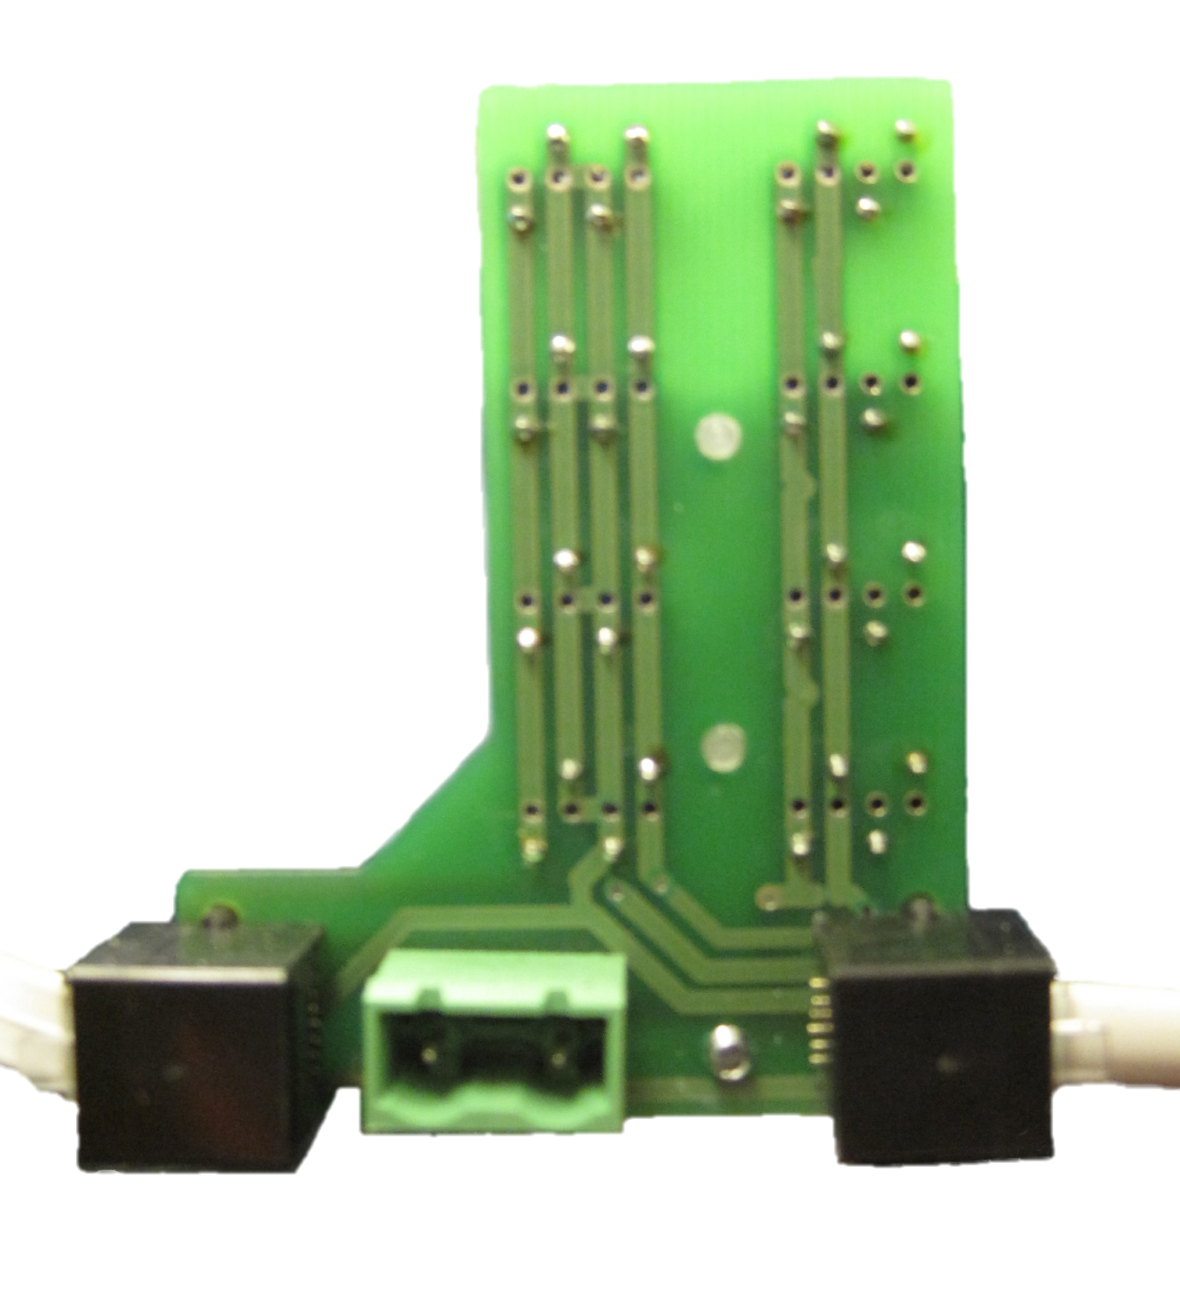
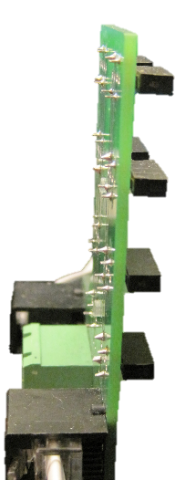
CAN-cards
Generic CAN-cards with shields
Thruster
INS Board
Sensor card
LED
Hydrophone
Stacked
Notes:
4.4 still in Naiad
More PWMs
Motors
New stacks
Connectors
More levels, not all used at the same time

Slide 9
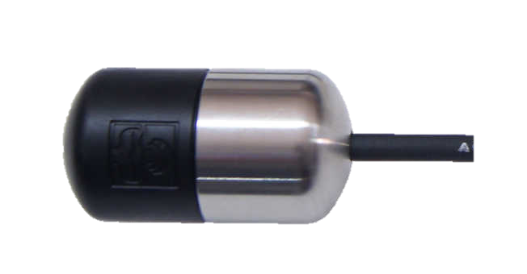
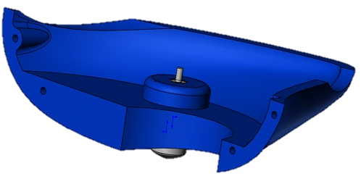
Hydrophones
Lars – board
Custom made boards
Notes:
Detect pinger in Robosub 3 hydrophones
H2c Hydrophones from aquarian audio products
2 on wings and 1 in rear part to facilitate multilateration of the pinger
Uses 1 Lars – board and two custom made boards which has digital filtering the signal from the hydrophones.

Slide 10
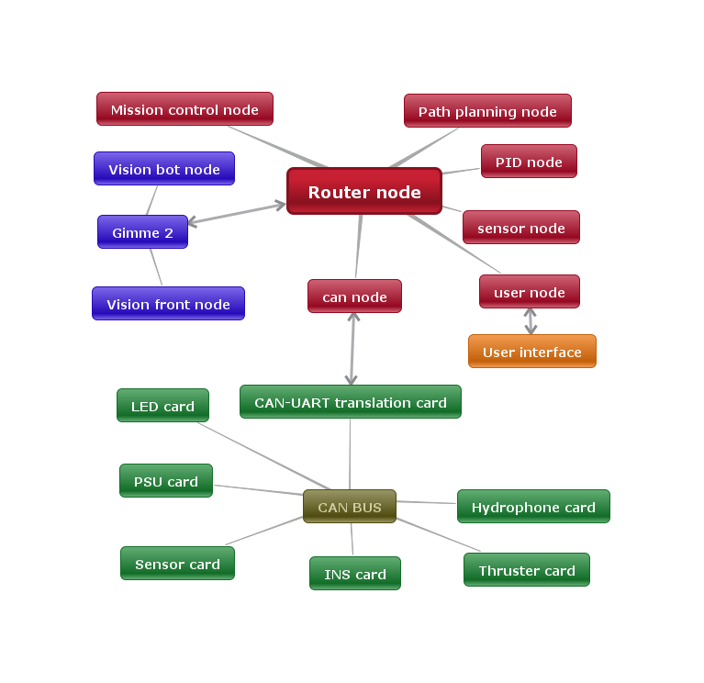
Node based software system
Three sub parts
Vision system
Naiad main control
Mission control

Slide 11
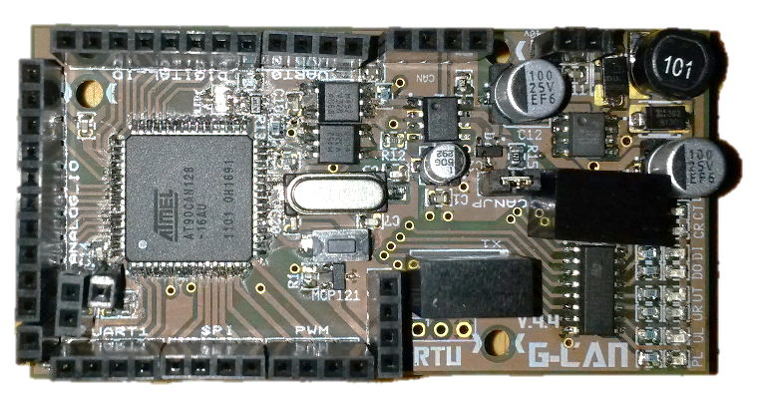
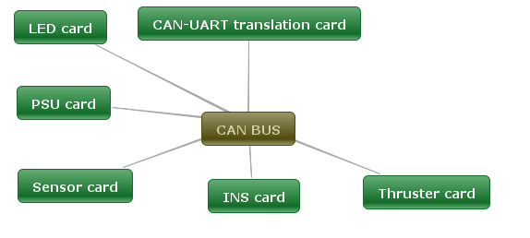
CAN-cards
Thruster
Sensor
Inertial Navigation System
LED
Translator
PSU
Hydrophone

Slide 12
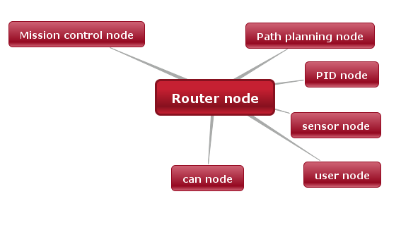
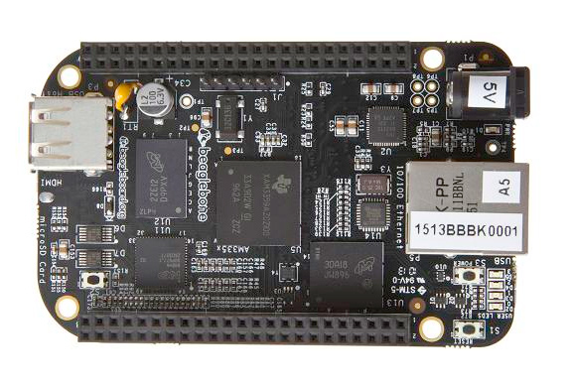
BeagleBone Black
Mission Control
Path planning
Motion control
Sensor fusion
External communication
CAN communication

Slide 13
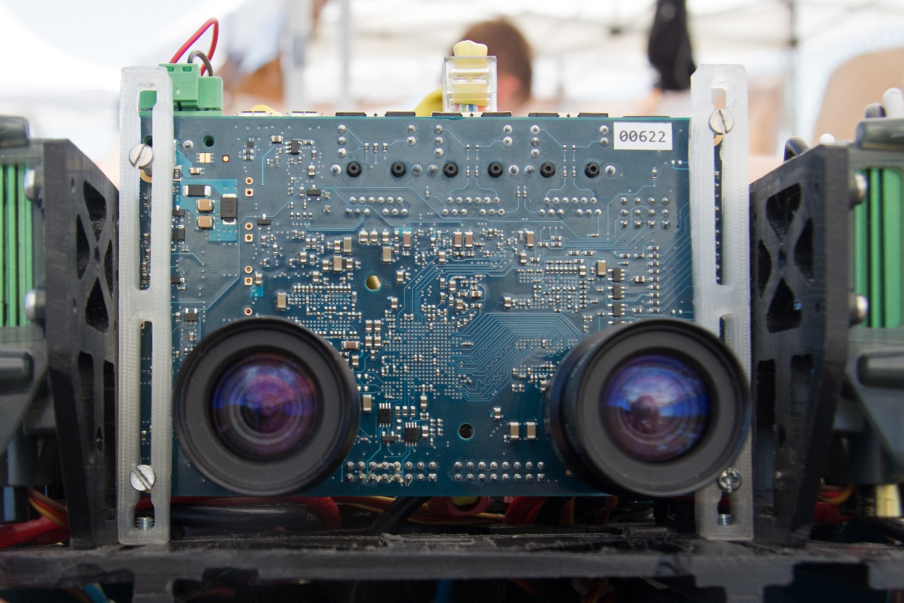
GIMME-2
Dual-core
FPGA
Peta Linux 2014.3
2x 10 megapixel cameras
Notes:
BILD!
Delivering:
RGB, HSI, disparity map, Harris –Stephen corner and edge detection
20 fps

Slide 14
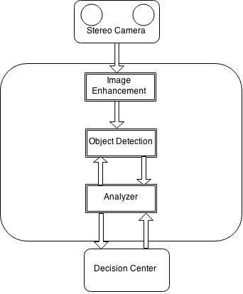
Vision system
Stereo vision
Filter
Object detection and analysis
Mission control support

